Slide 1

DEVELOPING A TOOL FOR Validation of A website
PRESENTED BY,
ABHISHEK FRANCIS KUJUR
(M120378CA)

Slide 2
ABSTRACT
We develop an application tool to extract words in a website. This application takes the URL of that website to crawl every page of a website and do spell check on them. It extracts the content of the website and checks for spelling. It identifies the spelling mistake in that website. Display the mistake in the content of the website. The output shows the corresponding links in which the mistakes exist allowing the administrator to correct them.

Slide 3
PROBLEM DEFINITION
This software helps to rectify spelling mistakes in the data. It uses its engine to process and scan all pages. Given a URL, it will scan every page linked to that URL.
The crawler begins with an initial URL to scan a website called seed. The first task of the crawler is to identify the hyperlinks on the webpage and use those links to further crawl called crawl frontier. If a website contains large volume of information it may take some time for the crawler to download. So the crawler has to select what information it wants to send down.

Slide 4
MOTIVATION
This problem is to be done because it will allow validation of a website. The software tool will benefit our own College website. It will keep it validated from time to time. We want proper information to be conveyed to the user of the website. It will ease down the workload of the site administrator by reducing the time to check/validate the website.

Slide 5
PROPOSED SYSTEM
The tool developed is novel in various aspects. It uses an initial link to extract the URLs. It uses this URL to get information from webpage. Additional functionality added to the tool is Spell checking. It extracts visible (readable) contents from a page, checks for incorrect words. It has an added feature of word suggestion which allows user to select the correct word. It is a combination of all the elements that is not present in the existing system. All these features make a great tool for website validation.

Slide 6
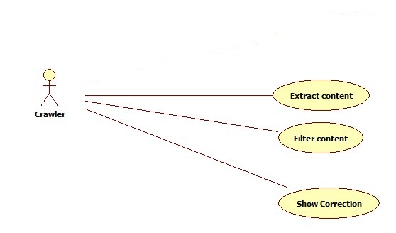

MAIN USE CASE DIAGRAM

Slide 7
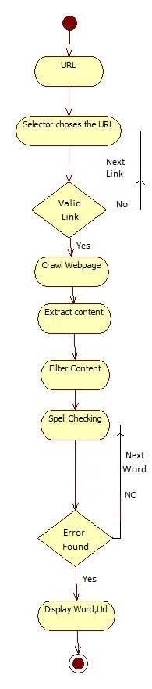
ACTIVITY DIAGRAM

Slide 8
Different stages of validation
Link Feed
Download Content
Separate Information
Spell Checking
Show Correction

Slide 9
LINK FEED
1. Input URL (www.nitc.ac.in).
2. Link used to Crawl webpage.
Download Content
1. The Selected URL is used by the software to browse.
2. It goes the link of the website.

Slide 10
3. Download the webpage.
Separate Information
1. Download the web page.
2. Pass through the filter.
3. Filtered content is separated.

Slide 11
Spell Checking
1. Pass the extracted content through spell checker.
2. Checks for uncorrected spelling.
Show Correction
1. Uncorrected word found.
2. Display the uncorrected word corresponding with URL and suggest correct words.

Slide 12
IMPLEMENTATION
MODULE
Crawler module is the heart of this application which performs several vital processes like use of list of URL to download the webpage and extract content.
The list of python packages which are used in this application are as follows:
Beautiful Soup
Requests
Re
enchant

Slide 13
Non-functional requirements
Performance Requirements
Capacity: The system uses one user from where the tool is installed.
Network Connection: Whenever the software is used it should be connected to the internet.
Resource Usage: It will use maximum 100mb.

Slide 14
Constraints
One of the main constraints of the Validation of website tool is the time to parse all the webpage of the website. Accessing all the webpage, filtering and checking the spelling error takes time need to keep it as low as possible.
Another constraint is bandwidth speed.

Slide 15
Work Done
1. Extraction of URL from webpage is achieved.
Extraction of content from webpage.
Spell Checker incorporated to identify misspelt words.
Extra feature added (suggestion of words).

Slide 16
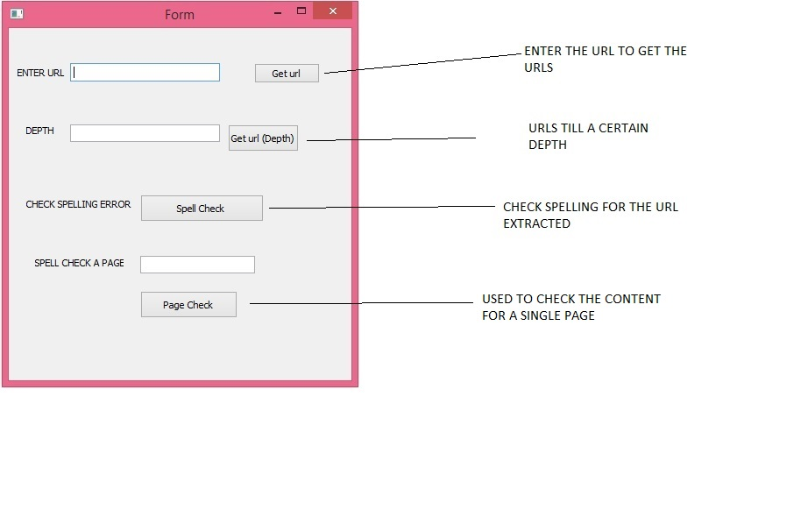
SOFTWARE - GUI

Slide 17
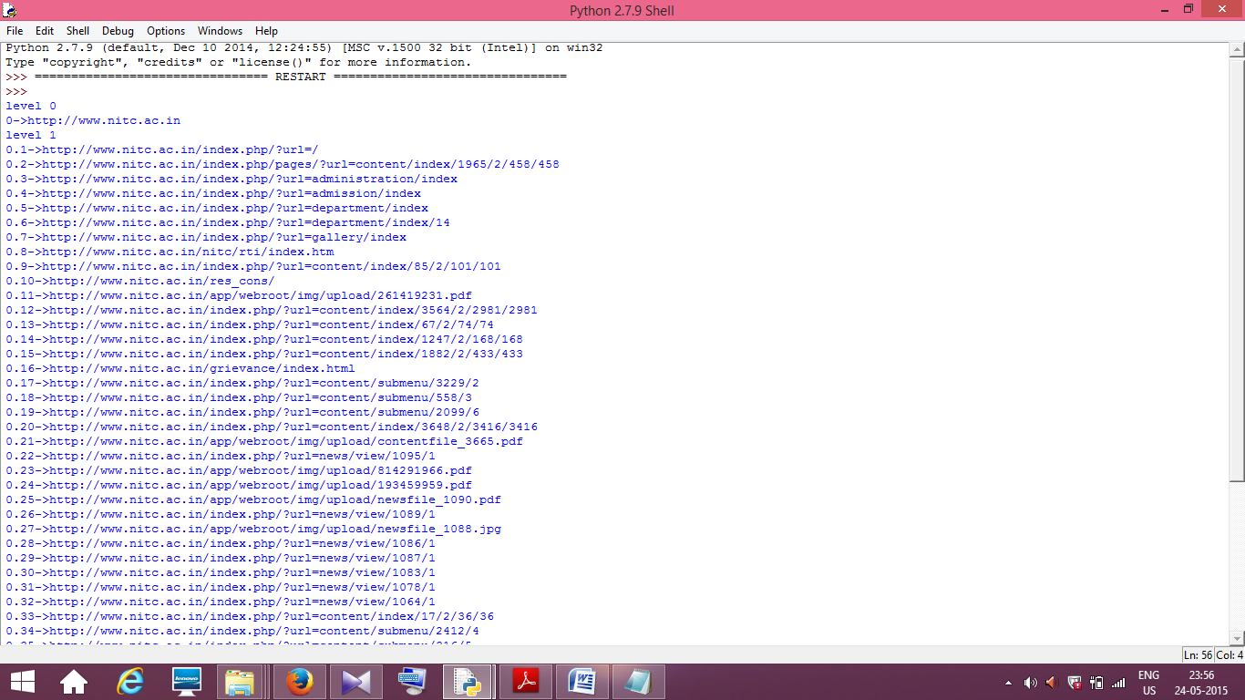
SCREENSHOT
EXTRACTION

Slide 18
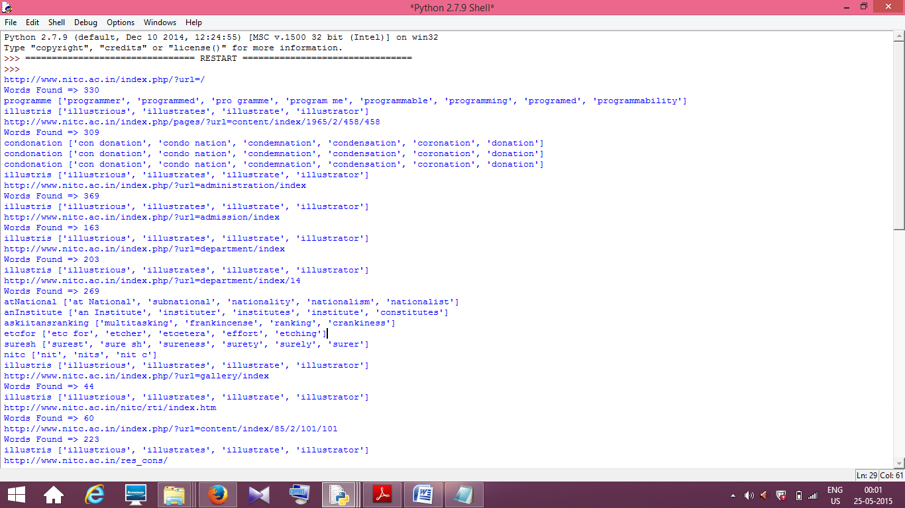
SPELL CHECKING

Slide 19
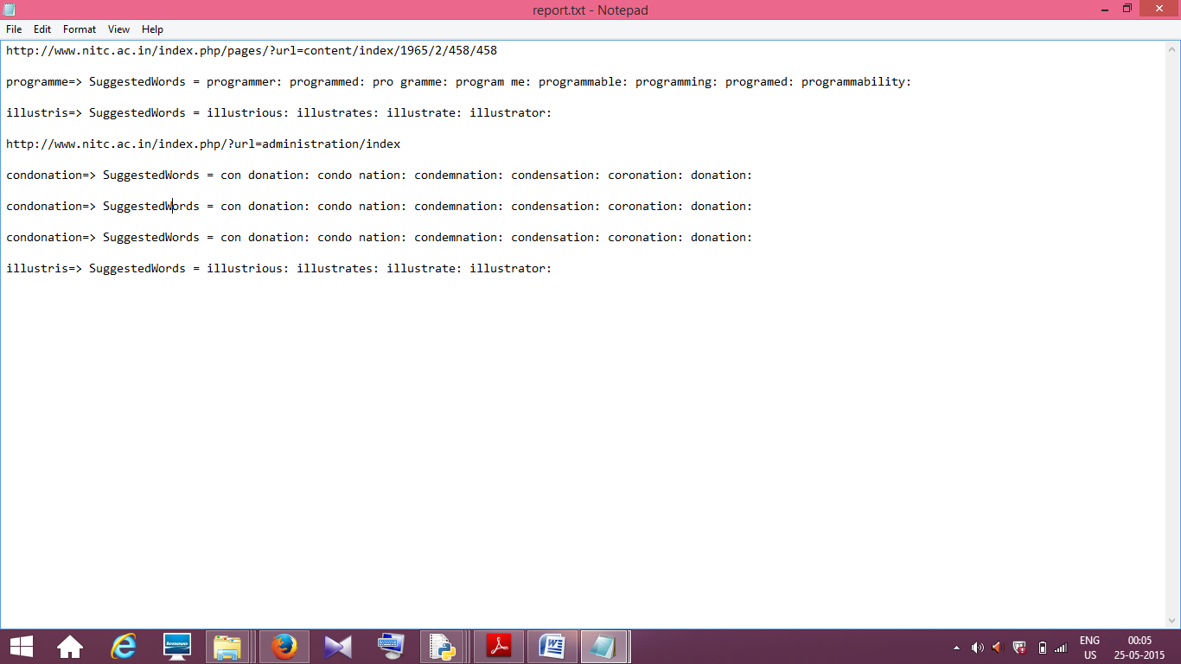
REPORT GENERATED

Slide 20
CONCLUSION
This system extracts, collects and integrates the data from different levels of a website successfully. Each wrongly spelt word is identified and corresponding suggestions shown. Regular expressions were effectively employed to get rid of false positives – Names, URLs, acronyms etc.
Future Work
Future development of the software involves notifying the part of the page where the incorrect word occurred. This will allow the administrator to find the incorrect words quickly and replace it with the relevant word.

Slide 21
GIT HUB
Project Link:
https://github.com/ABHISHEKFRANCIS07/repo_m120378ca/blob/master/toolforvalidationofwebsite.py

Slide 22
REFERENCES
[1]. https://docs.python.org/3/tutorial/index.html Accessed on Feb 2015.
[2]. http://www.tutorialspoint.com/ Accessed on March 2015.
[3].https://www.youtube.com/watch?v=4Mf0h3HphEA&list=PLEA1FEF17E1E5C0DA
Accessed on March 2015
[4]. https://media.readthedocs.org/pdf/requests/latest/requests.pdf Accessed on March 2015.
[5]. https://docs.python.org/2/library/urllib2.html Accessed on May 2015

Slide 23

QURIES??...

Slide 24


